Slide 1
Smart Jacket
Team Name : ENIGMA
Team Members :
Revathy R Varma
Sanjali Sajith
Vishnu Raj
Abhishek Jayakumar

Slide 2
Contents:
Objective
Introduction
Problem Statement
Solution
Components Required

Slide 3
Contents:
6. Block Diagram
7. Working
8. Create an Application to Monitor the Health Status
9. Future Scope
10. Conclusion

Slide 4
Objective :
The main aim of the wearable smart jacket is to record a patient’s medical data using sensors and to send this data via wireless network to inform the doctor about the patient’s health.

Slide 5
Introduction:
Monitors Blood Pressure
Monitors Heart Rate
Smart Jacket
Monitors Breathing and oxygen saturation
Monitors Body Temperature

Slide 6
Problem Statement :
Patients need to wait for long time for their checkup at hospitals
Time consuming procedure
Chance of human error while taking the manual reading
Extra man power required
Non-availability of nurse at the time of critical condition.

Slide 7
Problem Statement :
No provision to check their health at home
Patient's data (temperature, heart rate, ECG, position) will be frequently measured and sent to server
Early detection and diagnosis of potentially fatal physiological conditions such as heart attack require continuous monitoring of patients health following transfer from hospital to home

Slide 8

Solution :
Provide healthcare services such as health monitoring, medical data access, and communication with the healthcare provider
Continuous health monitoring
Monitor the physiological signals without the need of interruption in the patient’s normal life

Slide 9
Components required :
Raspberry Pi 3
Node MCU
Temperature Sensor LM35
Heart Beat Sensor
ECG Sensor
PPG Sensor
GSM Sim 800

Slide 10
Block Diagram :
Message to the specified doctor
Bio Sensors
GSM
Node MCU
Raspberry pi
Internet
Web server
User
Database

Slide 11
Working :
Start
Threshold values
Sensor values are collected by Raspberry pi
Value > Threshold value
No
Relax and continue
Send the output of Raspberry pi to computer by wireless c
Yes
Store the data
Send data to the doctor immediately

Slide 12
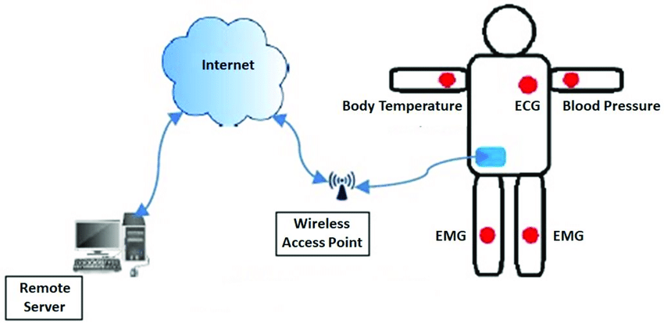

Slide 13
IoT :
Real-time monitoring via connected devices can save lives in event of a medical emergency like heart failure, diabetes, asthma attacks, etc.
Collect medical and other required health data
Smartphone app to transfer collected information to a physician

Slide 14
IoT :
The IoT platform used is Google Firebase for the synchronization of data
An open-source IoT application
The patient’s vital data is stored in the database of the firebase
It is retrieved from the Android App from anywhere

Slide 15
Create an Application to Monitor the Health Status
An app to monitor patients health
Displays necessary details

Slide 16
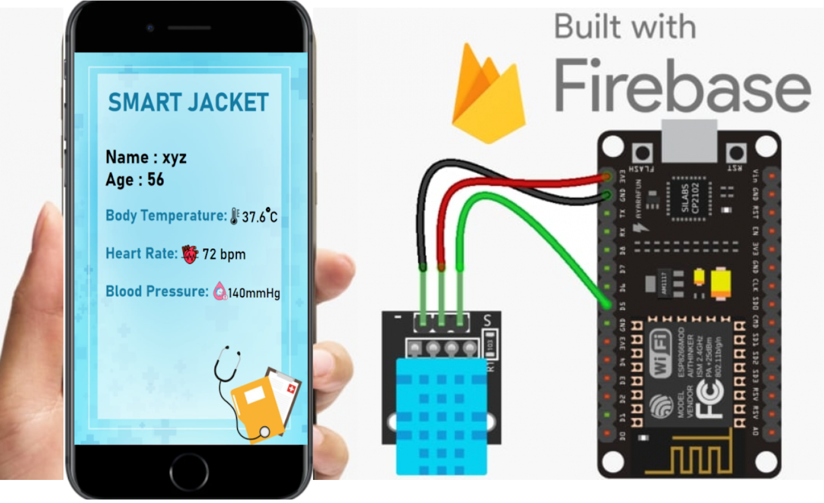

Slide 17
Future Scope:
Provide virtual medical assistance
Making affordable to common man with better technology
Pill Reminder settings

Slide 18
Conclusion :
Developed a solution for faster and easy health check up
Supports continuous monitoring of a patient’s health condition
Designed a user friendly mobile application

Slide 19
THANK YOU

